Slide 1
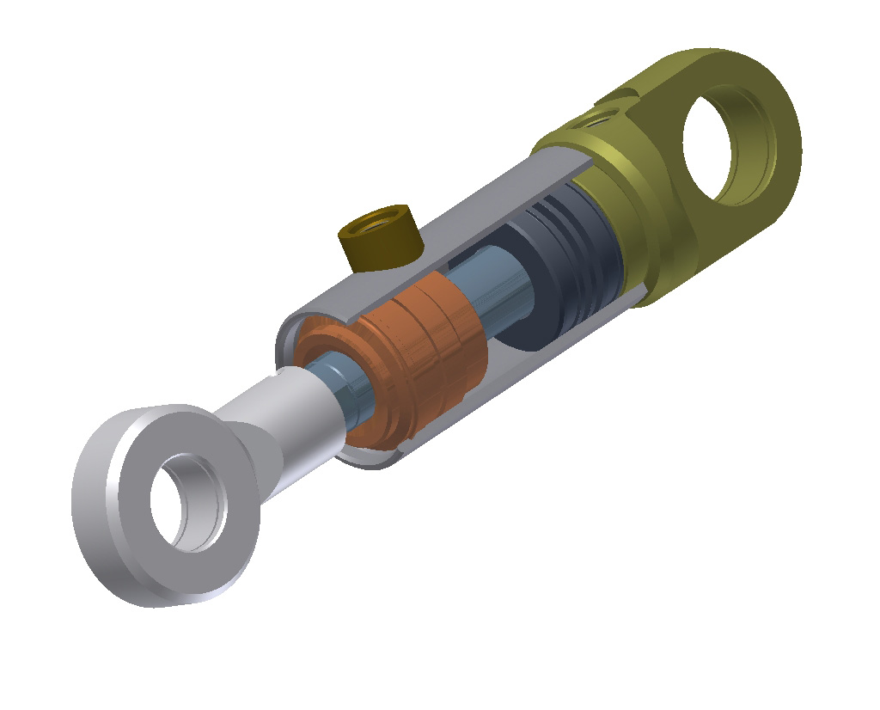

Slide 2
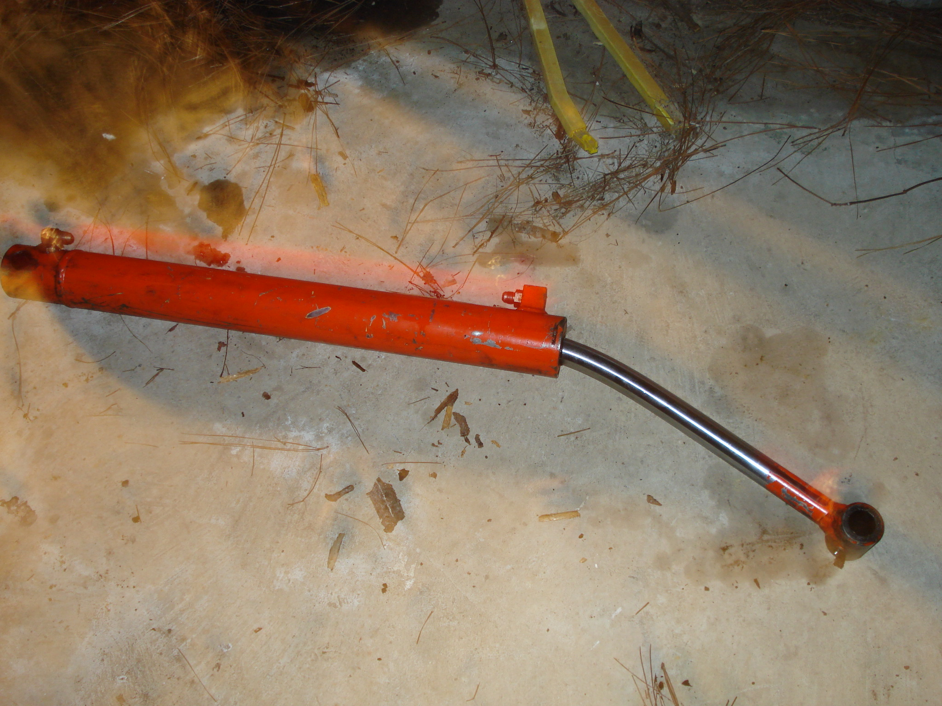
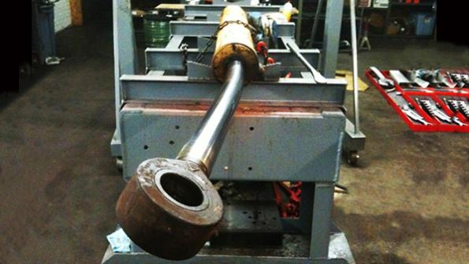
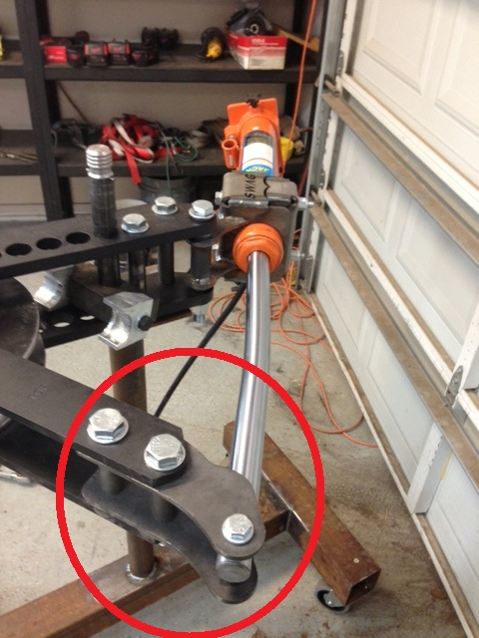
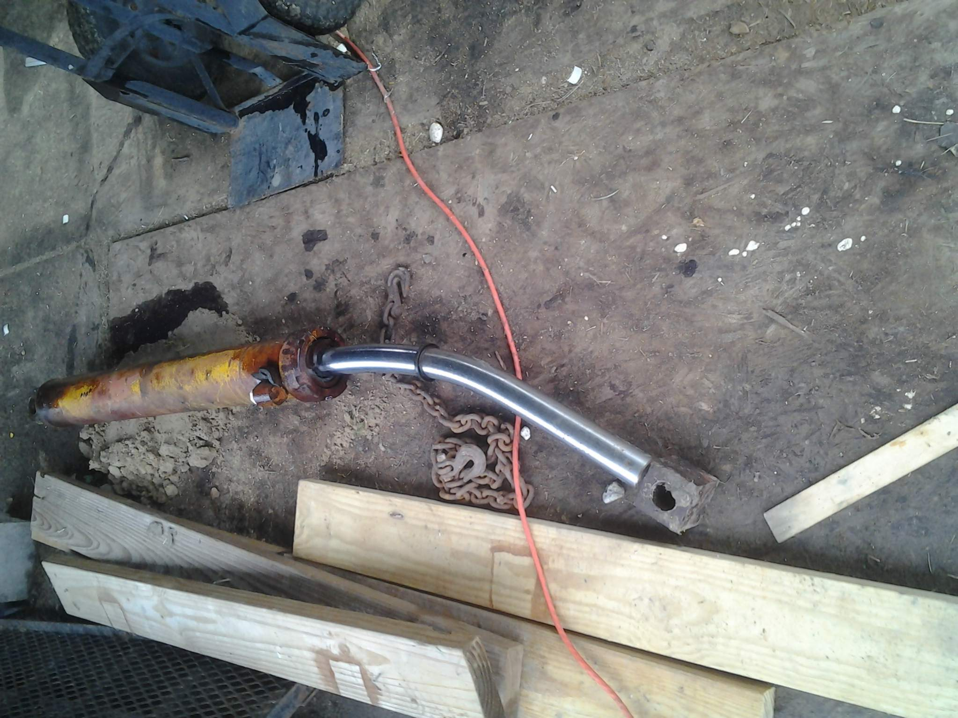
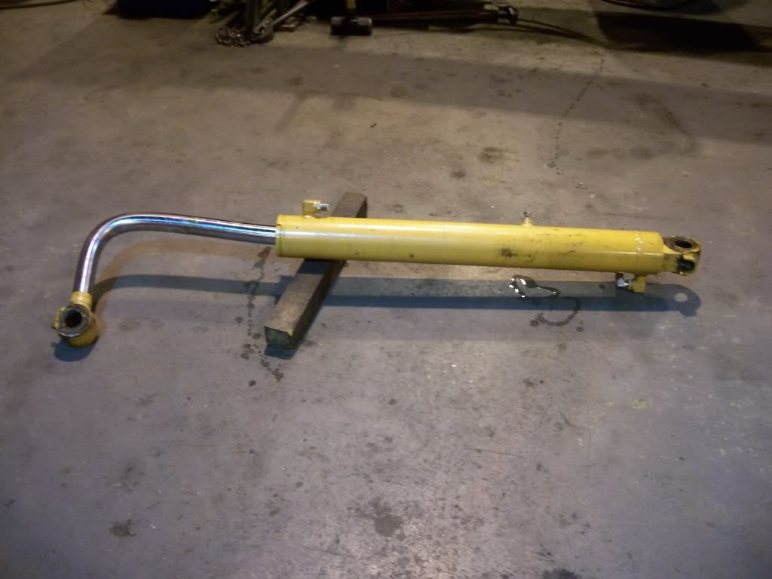
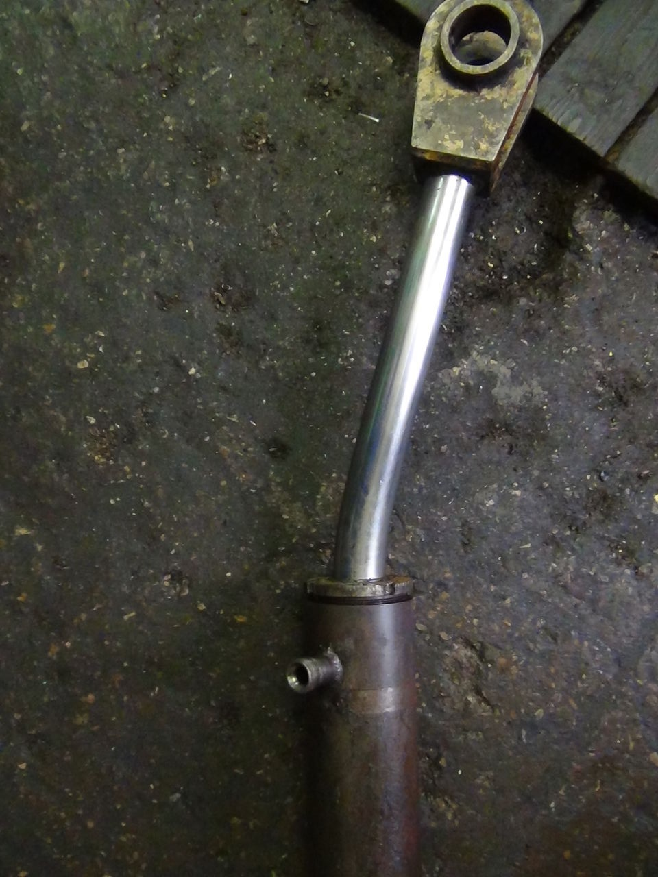

Slide 3
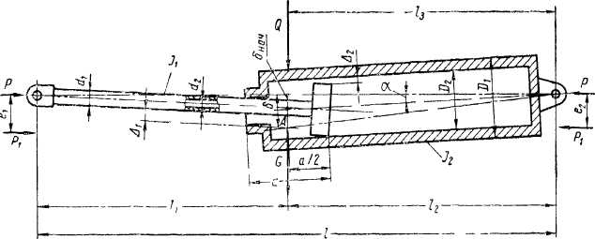

Slide 4
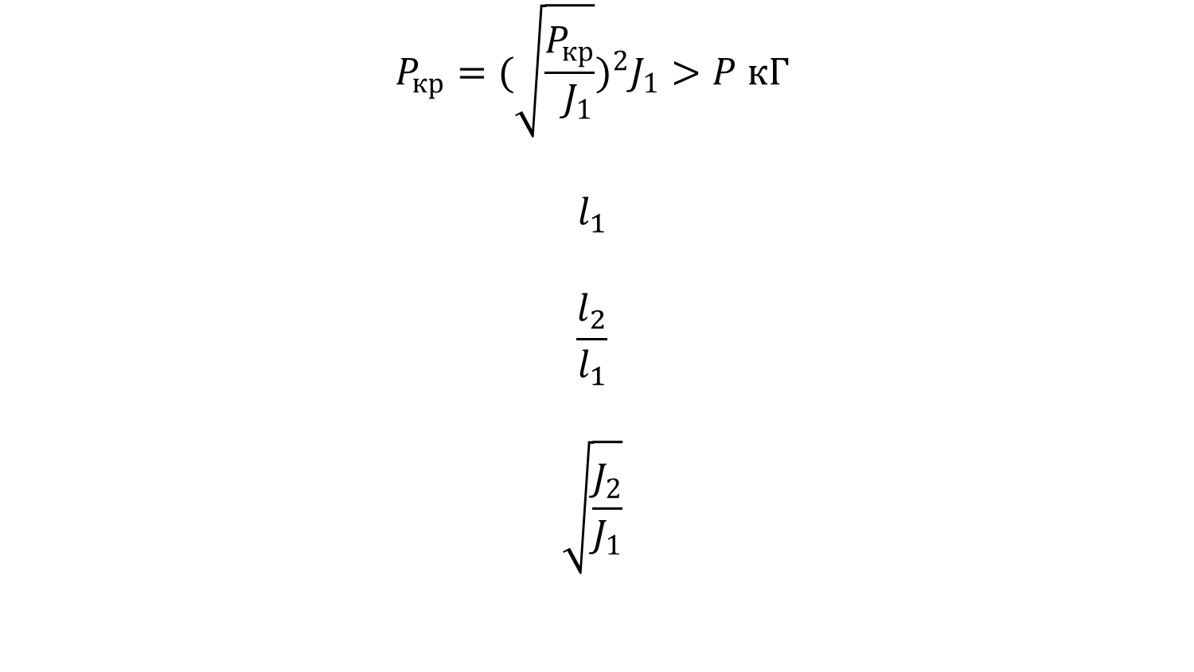
$$P_{кр}={(\sqrt{\frac{P_{кр}}{ J_{1}}})}^{2}J_{1}>P кГ$$
$$l_{1}$$
$$\frac{l_{2}}{l_{1}}$$
$$\sqrt{\frac{J_{2}}{J_{1}}}$$

Slide 5
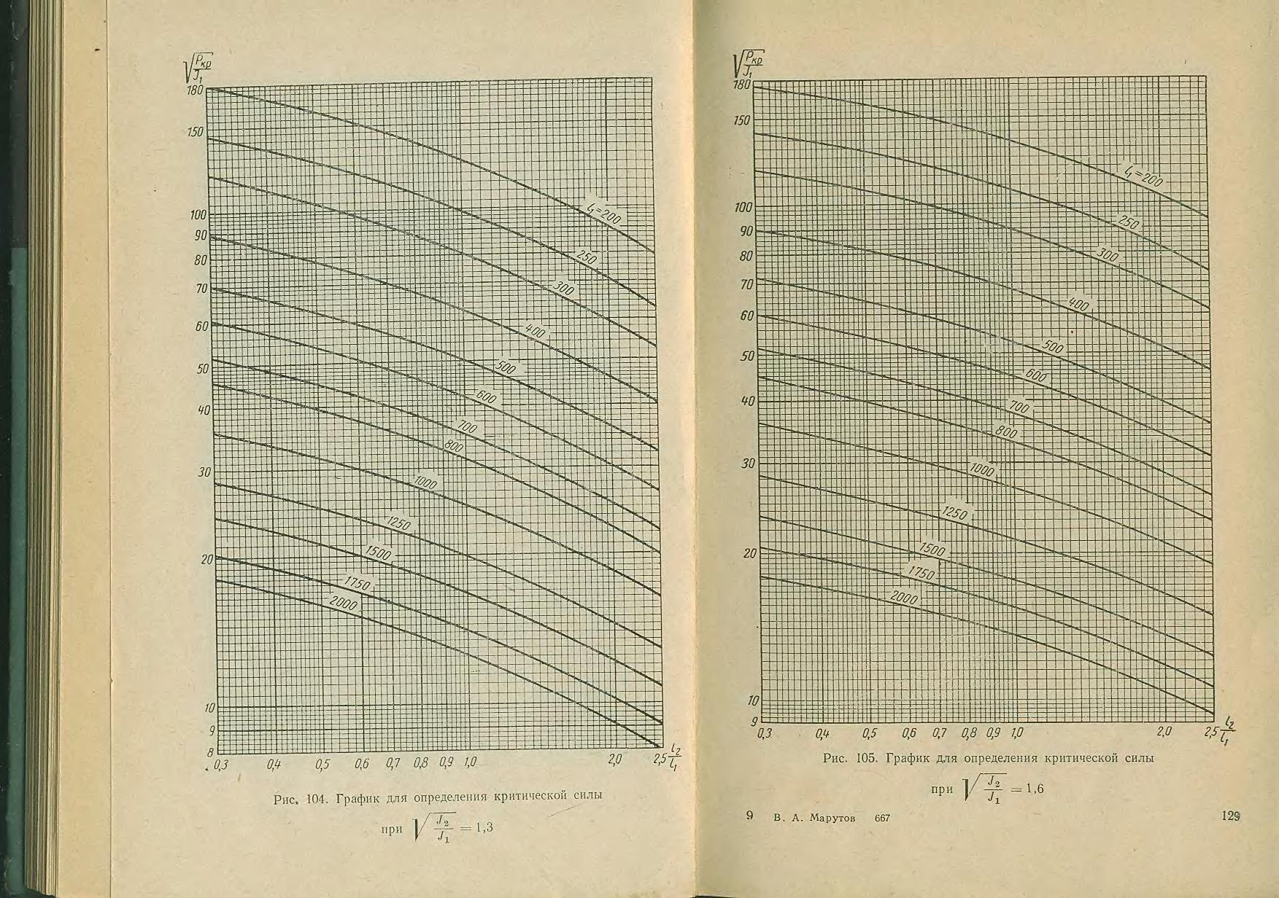

Slide 6
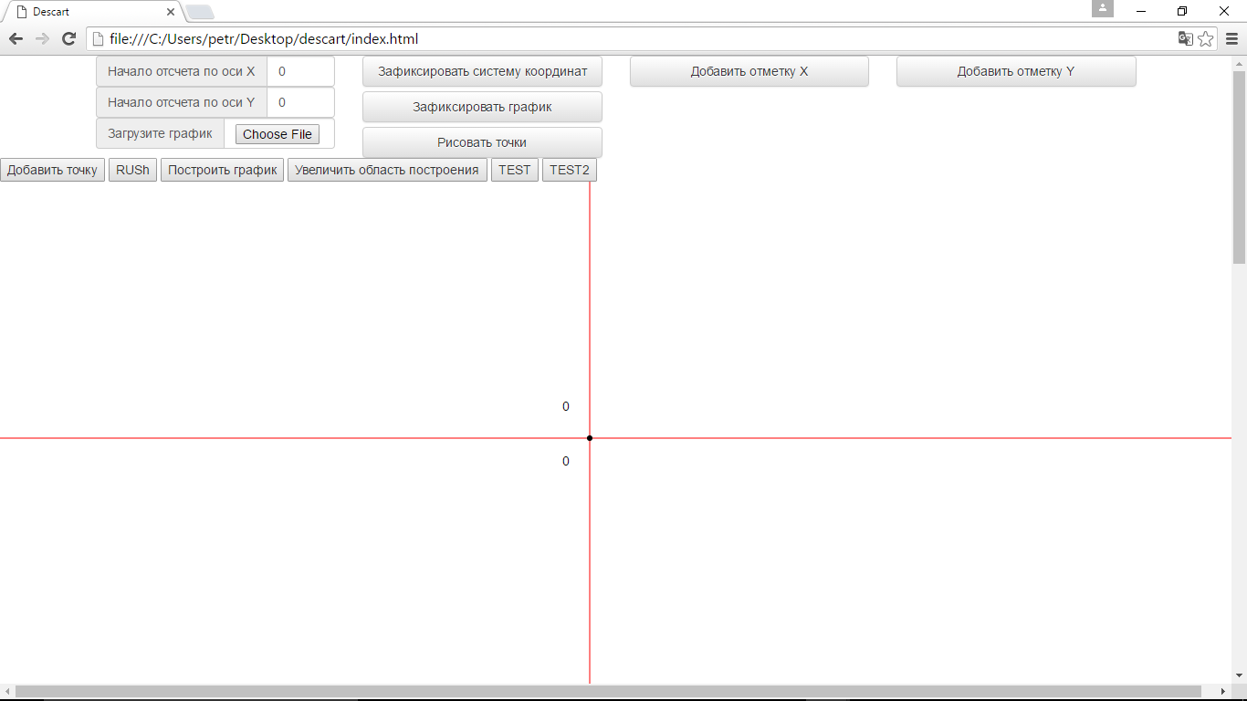

Slide 7
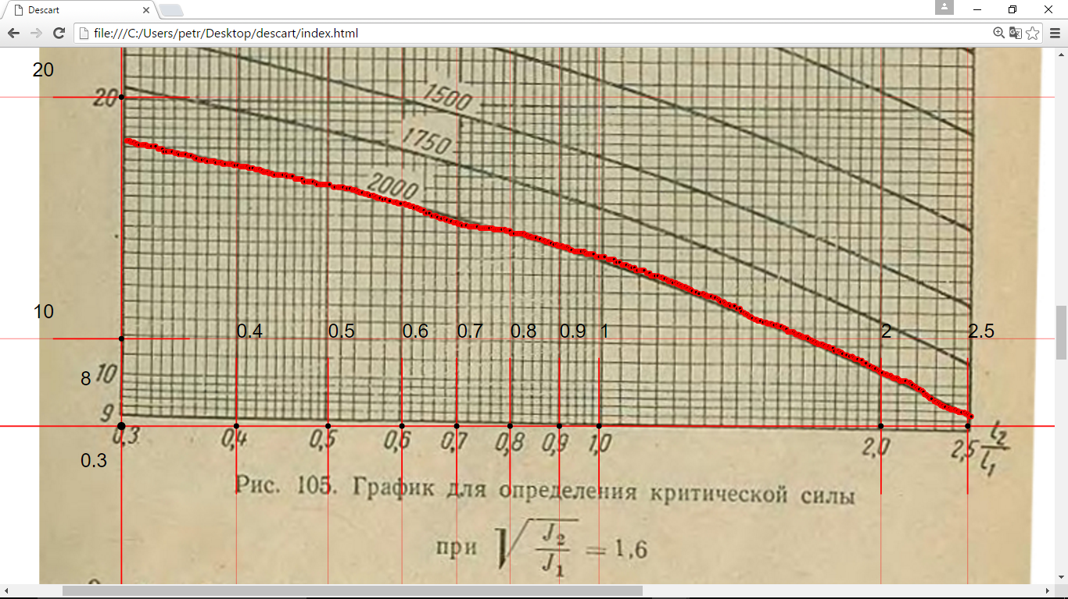

Slide 8
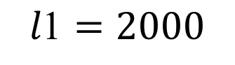
$$\text{l}\text{1}=2000$$

Slide 10
 | 1.1 | 1.3 | 1.6 | 2 | 2.5 | 3 | 4 | 5
200 | 117.4415 | 124.2863 | 132.4205 | 137.7523 | 141.8631 | 144.2213 | 147.4863 | 145.9222
250 | 92.21731 | 98.04881 | 104.8125 | 113.6091 | 112.6998 | 111.8406 | 120.9062 | 113.4151
300 | 77.79815 | 81.11251 | 88.91156 | 91.25763 | 92.82625 | 94.17487 | 101.3439 | 93.96642
400 | 58.74382 | 61.28688 | 64.40067 | 69.31035 | 68.40084 | 69.55097 | 74.04231 | 69.78366
500 | 46.80875 | 48.80153 | 51.08406 | 54.61382 | 55.68493 | 58.352 | 56.48317 | 57.8878
600 | 37.47849 | 41.35731 | 43.10591 | 45.77832 | 46.16528 | 47.60835 | 49.412 | 46.79202
700 | 30.58185 | 34.25938 | 36.70811 | 39.2347 | 39.62368 | 40.01938 | 41.61545 | 39.40668
800 | 26.66591 | 31.0705 | 32.14459 | 34.82428 | 34.4532 | 35.50176 | 36.35051 | 35.12055
1000 | 22.58457 | 24.82375 | 26.11017 | 27.7429 | 28.0737 | 28.86913 | 29.31631 | 29.04389
1250 | 17.95824 | 20.05162 | 21.31839 | 22.52362 | 21.96864 | 22.36331 | 22.7987 | 22.23322
1500 | 15.35498 | 16.94579 | 17.75138 | 19.17191 | 18.84867 | 18.99488 | 19.32439 | 19.20324
1750 | 12.96108 | 14.37485 | 15.89989 | 16.17439 | 16.21055 | 16.51911 | 16.04623 | 16.66774
2000 | 11.78972 | 12.68419 | 13.56169 | 14.11811 | 14.44413 | 14.68178 | 14.68178 | 15.03649
1.1 | 1.3 | 1.6 | 2 | 2.5 | 3 | 4 | 5
24493.34 | 22525.06 | 23844.02 | 25854.56 | 26982.31 | 27052.5 | 33114.19 | 26685.67
-1.0111 | -0.98541 | -0.98485 | -0.98849 | -0.99448 | -0.99198 | -1.01913 | -0.98966
1.011095 | 0.985409 | 0.984845 | 0.988493 | 0.994483 | 0.991979 | 1.01913 | 0.989659

Slide 11

 | 1.1 | 1.3 | 1.6 | 2 | 2.5 | 3 | 4 | 5
200 | -0.4218 | -0.37269 | -0.29314 | -0.23589 | -0.22395 | -0.18161 | -0.14586 | -0.17654
250 | -0.43879 | -0.38017 | -0.30997 | -0.24439 | -0.243 | -0.21225 | -0.14995 | -0.19586
300 | -0.44741 | -0.37665 | -0.31655 | -0.27393 | -0.2598 | -0.21437 | -0.15532 | -0.20296
400 | -0.43778 | -0.34986 | -0.32305 | -0.23139 | -0.23665 | -0.21534 | -0.16401 | -0.19364
500 | -0.44533 | -0.35893 | -0.33567 | -0.22999 | -0.22281 | -0.18541 | -0.18939 | -0.20561
600 | -0.47446 | -0.38676 | -0.31905 | -0.24863 | -0.23025 | -0.21316 | -0.18894 | -0.20854
700 | -0.46948 | -0.38775 | -0.31541 | -0.25262 | -0.2432 | -0.19067 | -0.19237 | -0.20548
800 | -0.46334 | -0.36686 | -0.29693 | -0.24349 | -0.24999 | -0.20264 | -0.16378 | -0.19857
1000 | -0.45462 | -0.34972 | -0.29122 | -0.25796 | -0.22686 | -0.20976 | -0.17459 | -0.18621
1250 | -0.4467 | -0.34232 | -0.28299 | -0.2374 | -0.23147 | -0.22096 | -0.18339 | -0.21302
1500 | -0.45125 | -0.35073 | -0.29268 | -0.23338 | -0.21964 | -0.20776 | -0.17264 | -0.18824
1750 | -0.45791 | -0.36705 | -0.30082 | -0.23174 | -0.2163 | -0.19991 | -0.18162 | -0.17315
2000 | -0.46654 | -0.3971 | -0.36209 | -0.2456 | -0.23927 | -0.21789 | -0.21789 | -0.1952
$$доумнажаем на минус$$
200 | 0.414265 | -0.66345 | 0.663446
250 | 0.426676 | -0.62005 | 0.620047
300 | 0.437649 | -0.60631 | 0.606307
400 | 0.410733 | -0.57838 | 0.578382
500 | 0.407213 | -0.55728 | 0.557277
600 | 0.430019 | -0.57056 | 0.570556
700 | 0.430317 | -0.58016 | 0.580156
800 | 0.42158 | -0.59674 | 0.596736
1000 | 0.412515 | -0.58412 | 0.584118
1250 | 0.385907 | -0.48635 | 0.486347
1500 | 0.403504 | -0.5788 | 0.578801
1750 | 0.418947 | -0.62575 | 0.625748
2000 | 0.445336 | -0.57352 | 0.573521

Slide 12
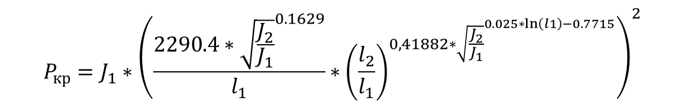
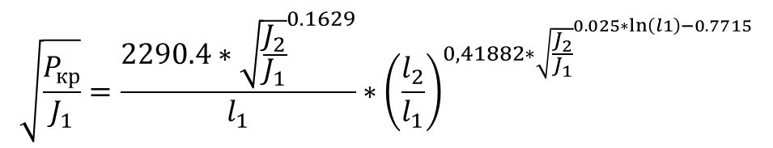
$$\sqrt{\frac{P_{кр}}{J_{1}}}=\frac{2290.4∗{\sqrt{\frac{J_{2}}{J_{1}}}}^{0.1629}}{l_{1}}∗{\left(\frac{l_{2}}{l_{1}}\right)}^{0,41882∗{\sqrt{\frac{J_{2}}{J_{1}}}}^{0.025∗\ln\left(l1\right)−0.7715}}$$
$$P_{кр}=J_{1}∗{\left(\frac{2290.4∗{\sqrt{\frac{J_{2}}{J_{1}}}}^{0.1629}}{l_{1}}∗{\left(\frac{l_{2}}{l_{1}}\right)}^{0,41882∗{\sqrt{\frac{J_{2}}{J_{1}}}}^{0.025∗\ln\left(l1\right)−0.7715}}\right)}^{2}$$

Slide 14
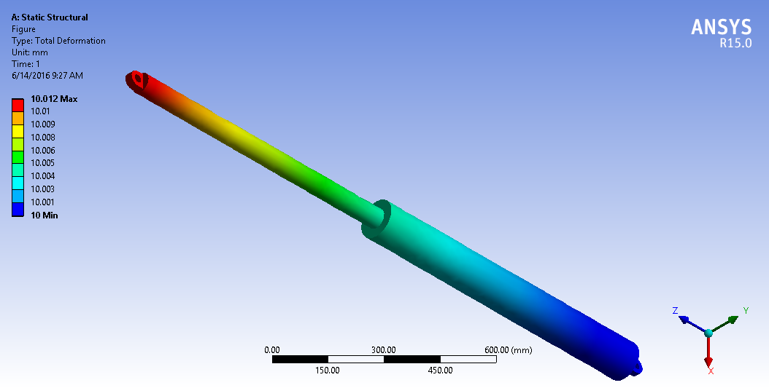

Slide 15
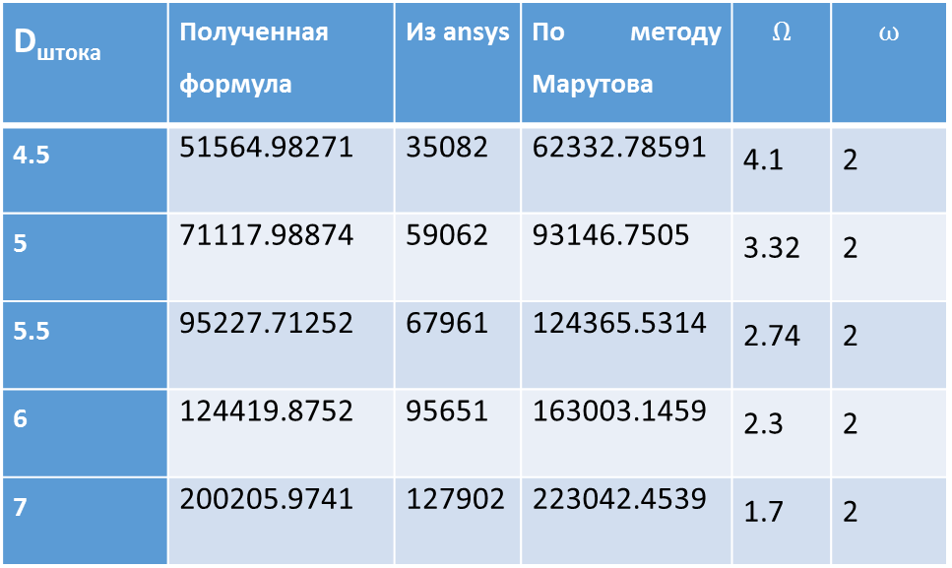
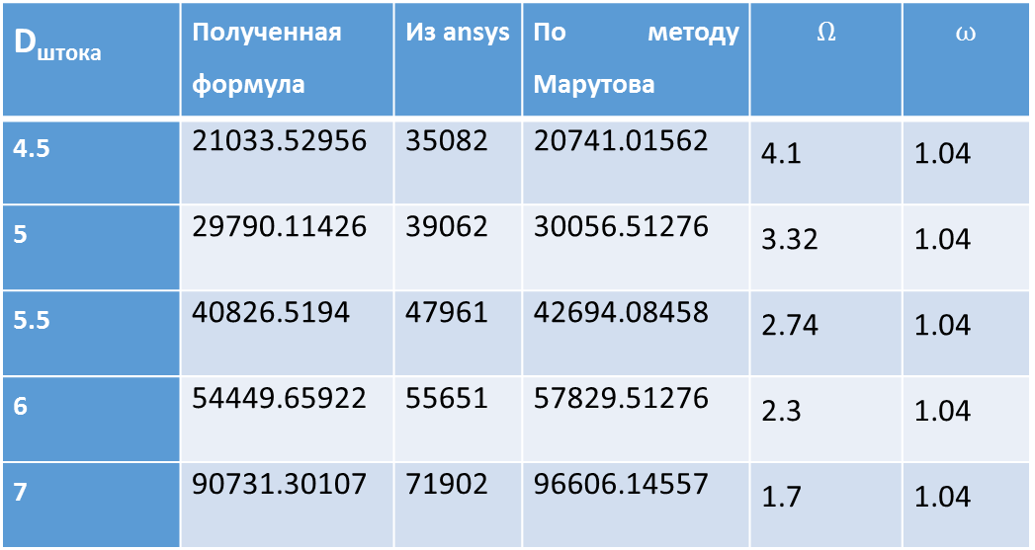
D_{штока} | Полученная формула | Из ansys | По методу Марутова | $$Ω$$ | $$ω$$
4.5 | 21033.52956 | 35082 | 20741.01562 | 4.1 | 1.04
5 | 29790.11426 | 39062 | 30056.51276 | 3.32 | 1.04
5.5 | 40826.5194 | 47961 | 42694.08458 | 2.74 | 1.04
6 | 54449.65922 | 55651 | 57829.51276 | 2.3 | 1.04
7 | 90731.30107 | 71902 | 96606.14557 | 1.7 | 1.04
D_{штока} | Полученная формула | Из ansys | По методу Марутова | $$Ω$$ | $$ω$$
4.5 | 51564.98271 | 35082 | 62332.78591 | 4.1 | 2
5 | 71117.98874 | 59062 | 93146.7505 | 3.32 | 2
5.5 | 95227.71252 | 67961 | 124365.5314 | 2.74 | 2
6 | 124419.8752 | 95651 | 163003.1459 | 2.3 | 2
7 | 200205.9741 | 127902 | 223042.4539 | 1.7 | 2

